Slide 1
Where the dragon to fly
Thank you very much for giving me a very big opportunity to participate in our home named EduHeart, which is my biggest honor and happiness. I try my best to contribute to our EduHeart as much as possible. Congratulations to our very successful memorandum today and so I cannot say more than that honey, moved and fired sentences to all of you. Currently, I will submit a book about applied optimization to our EduHeart soonest and intend to submit a short book or monograph about neural network or generative AI. As you known, generative AI is being the hot topic, especially, there are some miracle applications such as ChatGPT and Bard. In education, generative AI is more than potential, not only tutorial and helper applications but also creative applications to create new solutions, new puzzles, new game learning methods. For instance, in the next slide, there is a dragon, a tiger, along with a background of bamboo tree, generative AI application can generate orbits or moving journeys of the dragon (the next slide is the illustration of movement, which is not the realistic generation yet).

Slide 2
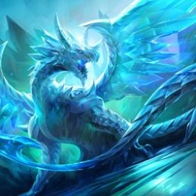
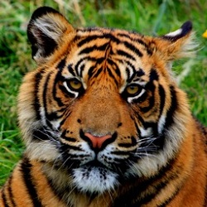
Where the dragon to fly
However, indeed the generative AI application needs to know some basic orbits of dragon and tiger (as seen in next figure) to estimate variants of their orbits. Moreover, as you see, the bamboo background is not changed much, and some swallows are flying happily, healthily, and freely. Of course, the number of the swallows is more than two or three.

